Slide 1

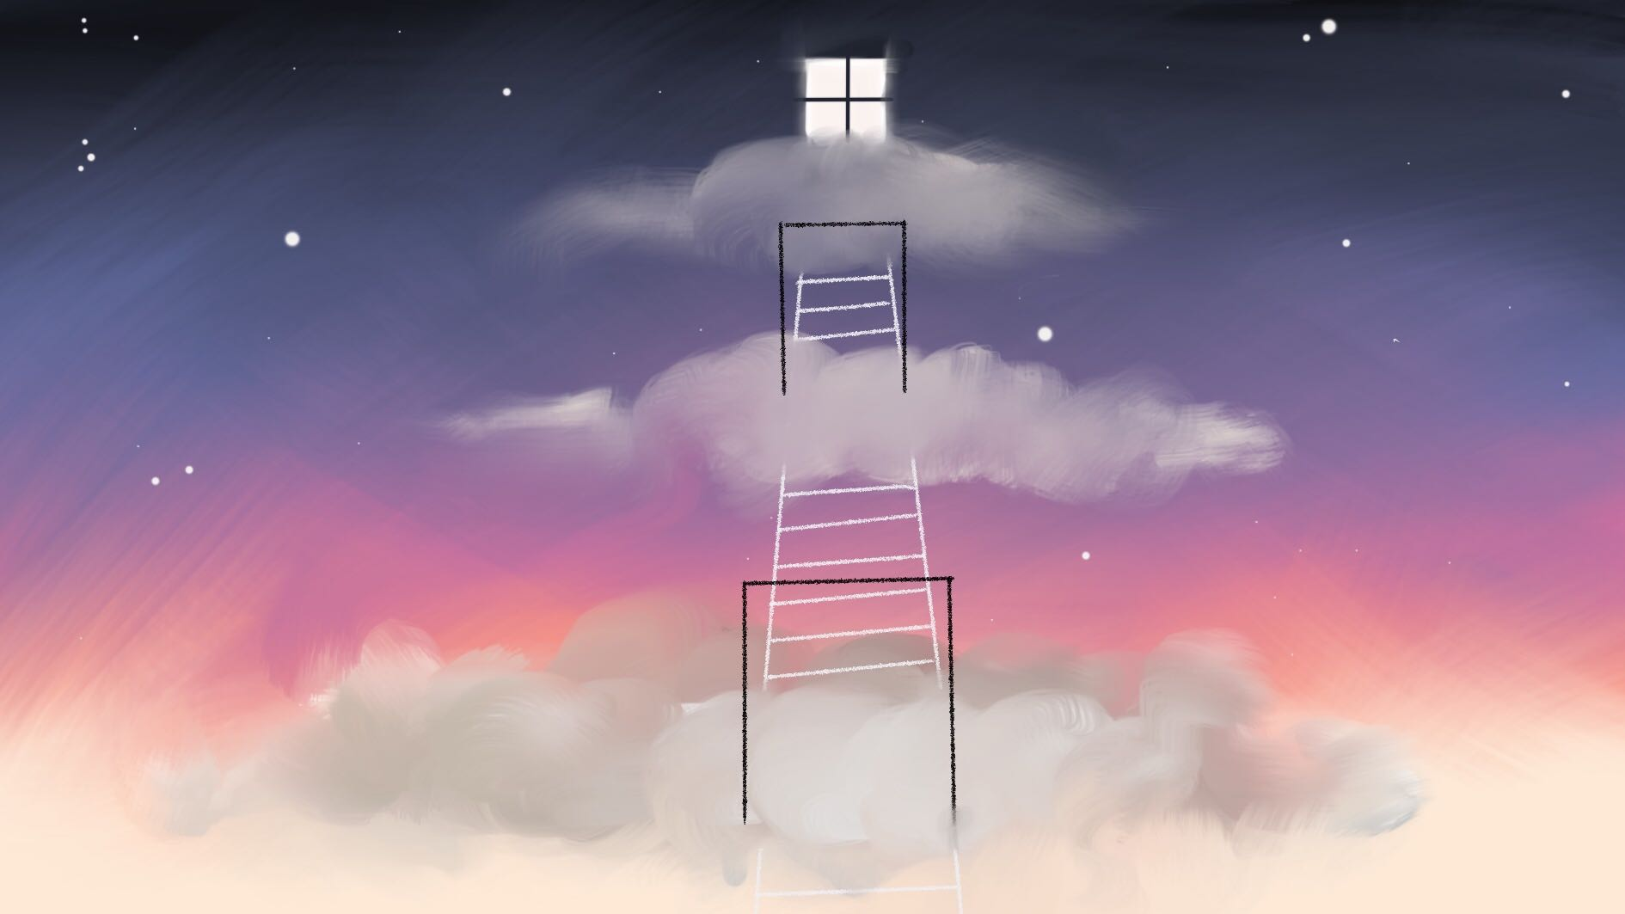
WHAT BECOMES OF THE BROKEN HEARTED?
- TEAM PROJECT HEART -
Collaborative project. Narrative Game. ST_2019

Slide 2
TEAM PROJECT HEART
IGNACIO
Writer & Designer
ALBA
Project Lead & Character Artist
FREDERYK
Programmer,
VFX & Music
MARIA
Environment Artist

Slide 3
Video 3min:
Quote playing out + showing anxiety
Showing lvl structure from above
Intersctions with sports water bottle & baseball bat showcasing flavor text
Emotion slide → showing characters “interact”
Mood progression slide playing

Slide 4
Inside Diego's Heart you, as his anxiety, are trying to process his past relationship either through using violence or patience to soothe his aggravated emotions.
https://www.youtube.com/watch?v=zB0hJtk_rmw&feature=youtu.be

Slide 5
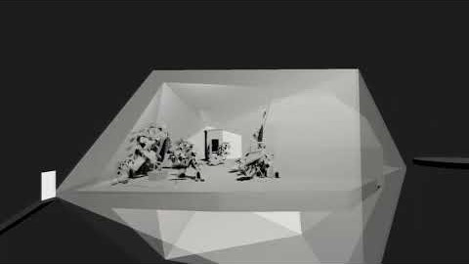
https://www.youtube.com/watch?v=zB0hJtk_rmw&feature=youtu.be

Slide 6
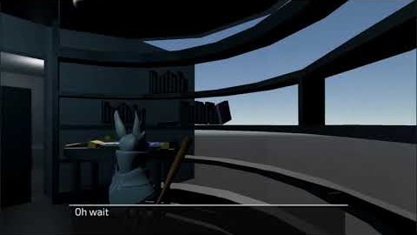
https://www.youtube.com/watch?v=zB0hJtk_rmw&feature=youtu.be

Slide 7
Emotion slide → showing characters “interact”

Slide 8


Slide 9
ARTWORK

Slide 10
Video 2min:
Turnarounds of the characters
Speedmodeling/painting videos
Animation showcase in Unity

Slide 11
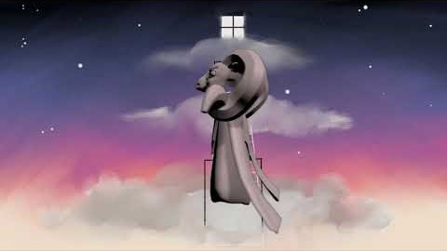
CHARACTERS
https://www.youtube.com/watch?v=XtkXTQuyZ1M&feature=youtu.be

Slide 12
Video 2min:
Camera “flying” through all the levels in chronological order
Depending on what level/room is shown the concept art for said room is present in the rightbottom corner
Showcasing of some items (plants, creative furniture etc)

Slide 13
GAMEPLAY
ENVIRONMENTS
https://www.youtube.com/watch?v=uDbhrds7od4&feature=youtu.be

Slide 14
PROGRAMMING

Slide 15
Video 3min:
1) Speedrun of the first level in its complete entirety, starting on the cloud placeholder

Slide 16
DEMO
PROGRAMMING
https://www.youtube.com/watch?v=zo9CFIUnAOo&feature=youtu.be

Slide 17



* basic structure based on
presentations
= main objectives
*cluster of assets
* accessibility of most recent game build
* weekly ~sprints~
= small objectives
* quick feedback
* knowledge of what everyone is working on at all times
* lists of assets, mechanics, animations, sounds etc.
* summary of game ideas
* all resources available
* personal deadlines
PLANNING & EXECUTION

Slide 18
THANK YOU FOR LISTENING
Collaborative project. Narrative Game. ST_2019

